Slide 1
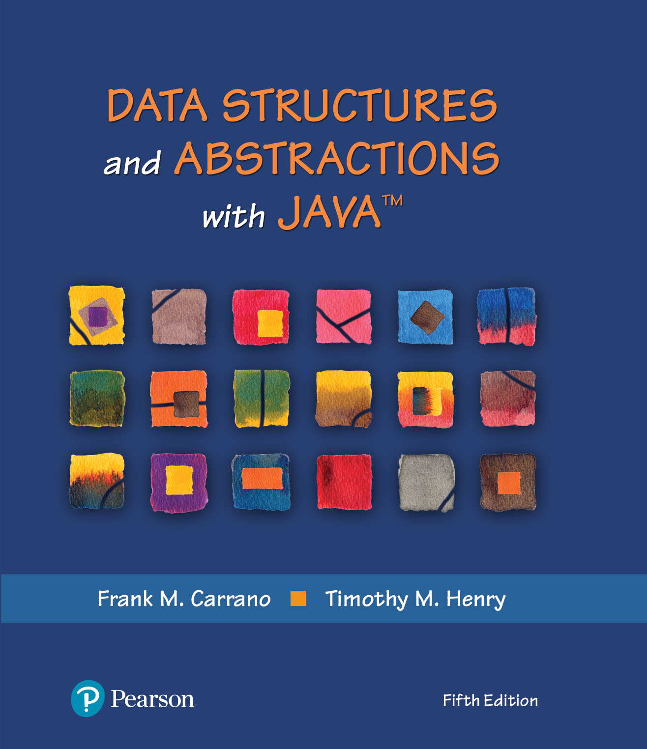
Data Structures and Abstractions with Java™
5th Edition
Module 1
ADT Data Structures
Using:
Chapter 1 – ADT Bags

Slide 2
Topics
Data
Data Organization
Abstraction
Procedural abstraction
Data Abstraction
ADT: BAG
Design – Unusual conditions
Interface for BAG ADT
Using the BAG ADT
Set ADT
Content can be found in Data Structures and Abstraction with Java by Carrano & Henry

Slide 3
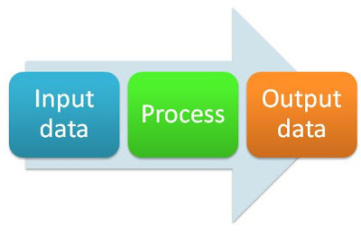
Data
Data is information
Information input to, generated by, or output from a program
e.g., your name, or address, or telephone number
Typical sources and destinations of data
the user, disk files, other computers, and the web
Programs process data

Slide 4
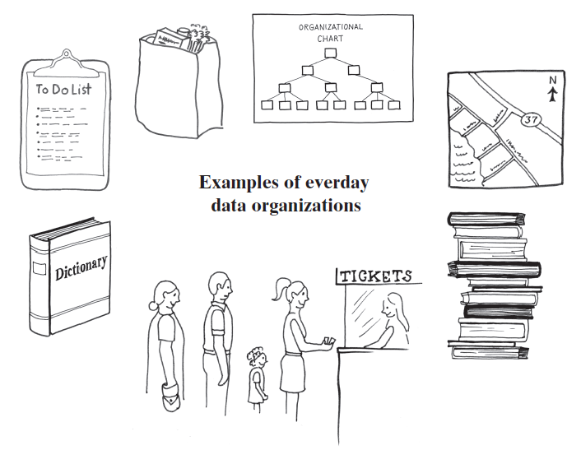
Data Organization in Life
Standing in a line
Stack of books
To-Do list
Dictionary
Folders, directories on your computer
Road map

Slide 5
Data Organization
Computers need a way to organize their data
Represented by ADT – Abstract Data Type
Data that is stored
Operations on that data
Data Structure – implementation of a ADT
Collection – ADT that contains a group of objects
Bag
List
Stack & Queue
Dictionary
Tree
Graph

Slide 6
Abstraction
The idea of knowing how to use something without knowing how it is implemented
We all use cars, but few of us could design and build one
Applies to methods and data structures
Two types of abstractions in computer science
Procedural abstraction
Data abstraction (Abstract Data Types, ADTs)

Slide 7
Procedural Abstraction
The idea that to use a method
We need only know
What is does (to decide when to invoke it)
How to invoke it (its signature)
We need not know how it works (its algorithm)
This allows us to build upon other peoples
Knowledge (algorithms) and
Efforts (method coding and debugging)
Thus reducing the cost of software

Slide 8
Data Abstraction (Abstract Data Types)
The idea that to use a data structure
We only need to know
What the operation methods do (to decide when to invoke them)
How to invoke the operation methods (their signature)
We need not know the operation algorithms
This allows us to build upon other peoples
Knowledge (algorithms) and
Efforts (data structure implementation and debugging)
Thus reducing the cost of software

Slide 9
Standard Abstract Data Type
An ADT whose method signatures conform to a standard
Advantage is that an application’s data structure can be changed by changing
The declaration of the data structure object
Not the operation method invocations
Greatly reduces the cost of software maintenance
Example: Declare the standard method signature to add an element to a data structure as:
boolean add(T element)
You could then change the data structure from an array based list to a linked list without having to change the method signature to add an element to the data structure. You wouldn’t have to worry that the method to add an element to your new data structure was called “insert” or “addItem”, etc.

Slide 10
The ADT Bag
Definition
A finite collection of objects in no particular order
Can contain duplicate items
Possible behaviors
Get number of items
Check for empty
Add, remove objects

Slide 11
CRC Card
Bag
Responsibilities
Get the number of items currently in the bag
See whether the bag is empty
Add a given object to the bag
Remove an unspecified object from the bag
Remove a particular object from the bag, if possible
Remove all objects from the bag
Count the number of times a certain object occurs in the bag
Test whether the bag contains a particular object
Look at all objects that are in the bag
Collaborations
The class of objects that the bag can contain
FIGURE 1-1 A CRC card for a class Bag

Slide 12
Specifying a Bag
Describe its data and specify in detail the methods
Options that we can take when add cannot complete its task:
Do nothing
Leave bag unchanged, but signal client
Note which methods change the object or do not

Slide 13
Using UML Notation to Specify a Class
Bag
+getCurrentSize(): integer +isEmpty(): boolean +add(newEntry: T): boolean +remove(): T +remove(anEntry: T): boolean +clear(): void +getFrequencyOf(anEntry: T): integer +contains(anEntry: T): boolean +toArray(): T[]
FIGURE 1-2 UML notation for the class Bag

Slide 14
Design Decision
What to do for unusual conditions?
Assume it won’t happen
Ignore invalid situations
Guess at the client’s intention
Return value that signals a problem
Return a boolean
Throw an exception

Slide 15
An Interface (Part 1)
/** An interface that describes the operations of a bag of objects. */
public interface BagInterface<T>
{
/** Gets the current number of entries in this bag.
@return The integer number of entries currently in the bag. */
public int getCurrentSize();
/** Sees whether this bag is empty.
@return True if the bag is empty, or false if not. */
public boolean isEmpty();
/** Adds a new entry to this bag.
@param newEntry The object to be added as a new entry.
@return True if the addition is successful, or false if not. */
public boolean add(T newEntry);
/** Removes one unspecified entry from this bag, if possible.
@return Either the removed entry, if the removal.
was successful, or null. */
public T remove();
LISTING 1-1 A Java interface for a class of bags

Slide 16
An Interface (Part 2)
/** Removes one occurrence of a given entry from this bag, if possible.
@param anEntry The entry to be removed.
@return True if the removal was successful, or false if not. */
public boolean remove(T anEntry);
/** Removes all entries from this bag. */
public void clear();
/** Counts the number of times a given entry appears in this bag.
@param anEntry The entry to be counted.
@return The number of times anEntry appears in the bag. */
public int getFrequencyOf(T anEntry);
/** Tests whether this bag contains a given entry.
@param anEntry The entry to find.
@return True if the bag contains anEntry, or false if not. */
public boolean contains(T anEntry);
/** Retrieves all entries that are in this bag.
@return A newly allocated array of all the entries in the bag.
Note: If the bag is empty, the returned array is empty. */
public T[] toArray();
} // end BagInterface
LISTING 1-1 A Java interface for a class of bags

Slide 17
Using the ADT Bag
/** A class that maintains a shopping cart for an online store. */
public class OnlineShopper
{
public static void main(String[] args)
{
Item[] items = {new Item("Bird feeder", 2050),
new Item("Squirrel guard", 1547),
new Item("Bird bath", 4499),
new Item("Sunflower seeds", 1295)};
BagInterface<Item> shoppingCart = new Bag<>();
int totalCost = 0;
// Statements that add selected items to the shopping cart:
for (int index = 0; index < items.length; index++)
{
Item nextItem = items[index]; // Simulate getting item from shopper
shoppingCart.add(nextItem);
totalCost = totalCost + nextItem.getPrice();
} // end for
// Simulate checkout
while (!shoppingCart.isEmpty())
System.out.println(shoppingCart.remove());
System.out.println("Total cost: " + "\t$" + totalCost / 100 + "." +
totalCost % 100);
} // end main
} // end OnlineShopper
Program Output
Sunflower seeds $12.95
Bird bath $44.99
Squirrel guard $15.47
Bird feeder $20.50
Total cost: $93.91
LISTING 1-2 A program that maintains a bag for online shopping

Slide 18
Example: A Piggy Bank
/** A class that implements a piggy bank by using a bag. */
public class PiggyBank
{
private BagInterface<Coin> coins;
public PiggyBank()
{
coins = new ArrayBag<>();
} // end default constructor
public boolean add(Coin aCoin)
{
return coins.add(aCoin);
} // end add
public Coin remove()
{
return coins.remove();
} // end remove
public boolean isEmpty()
{
return coins.isEmpty();
} // end isEmpty
} // end PiggyBank
LISTING 1-3 A class of piggy banks

Slide 19
Example: Using A Piggy Bank (Part 1)
/** A class that demonstrates the class PiggyBank. */
public class PiggyBankExample
{
public static void main(String[] args)
{
PiggyBank myBank = new PiggyBank();
addCoin(new Coin(1, 2010), myBank);
addCoin(new Coin(5, 2011), myBank);
addCoin(new Coin(10, 2000), myBank);
addCoin(new Coin(25, 2012), myBank);
System.out.println("Removing all the coins:");
int amountRemoved = 0;
while (!myBank.isEmpty())
{
Coin removedCoin = myBank.remove();
System.out.println("Removed a " + removedCoin.getCoinName() + ".");
amountRemoved = amountRemoved + removedCoin.getValue();
} // end while
System.out.println("All done. Removed " + amountRemoved + " cents.");
} // end main
LISTING 1-4 A demonstration of the class PiggyBank

Slide 20
Example: Using A Piggy Bank (Part 2)
private static void addCoin(Coin aCoin, PiggyBank aBank)
{
if (aBank.add(aCoin))
System.out.println("Added a " + aCoin.getCoinName() + ".");
else
System.out.println("Tried to add a " + aCoin.getCoinName() +
", but couldn't");
} // end addCoin
} // end PiggyBankExample
Program Output
Added a PENNY.
Added a NICKEL.
Added a DIME.
Added a QUARTER.
Removing all the coins:
Removed a QUARTER.
Removed a DIME.
Removed a NICKEL.
Removed a PENNY.
All done. Removed 41 cents.
LISTING 1-4 A demonstration of the class PiggyBank

Slide 21
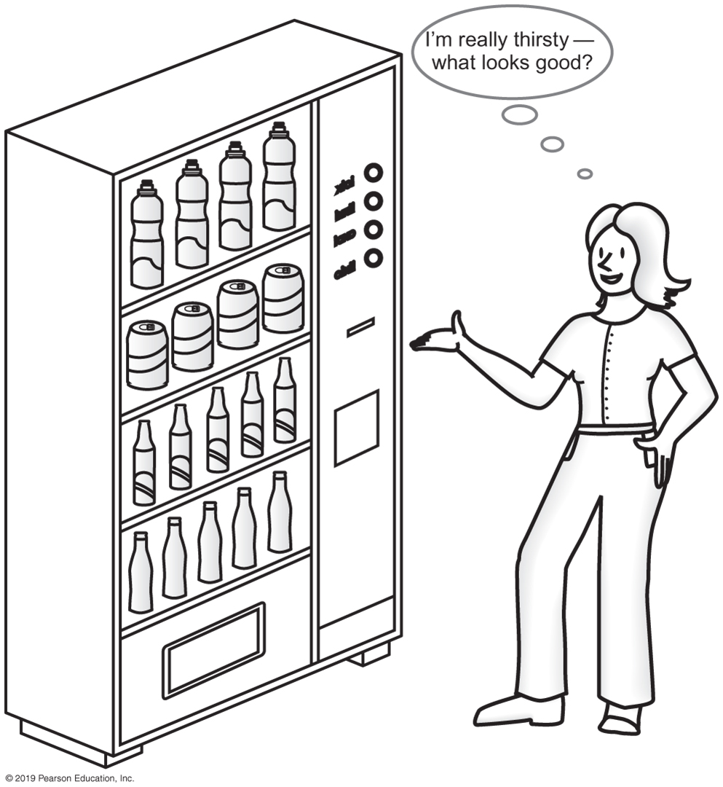
Observations about Vending Machines
Can perform only tasks machine’s interface presents.
You must understand these tasks
Cannot access the inside of the machine
You can use the machine even though you do not know what happens inside.
Usable even with new insides.
FIGURE 1-3 A vending machine

Slide 22
Observations about ADT Bag
Can perform only tasks specific to ADT
Must adhere to the specifications of the operations of ADT
Cannot access data inside ADT without ADT operations
Use the ADT, even if don’t know how data is stored
Usable even with new implementation.

Slide 23
User defined: Interface Set
/** An interface that describes the operations of a set of objects. */
public interface SetInterface<T>
{
public int getCurrentSize();
public boolean isEmpty();
/** Adds a new entry to this set, avoiding duplicates.
@param newEntry The object to be added as a new entry.
@return True if the addition is successful, or
false if the item already is in the set. */
public boolean add(T newEntry);
/** Removes a specific entry from this set, if possible.
@param anEntry The entry to be removed.
@return True if the removal was successful, or false if not. */
public boolean remove(T anEntry);
public T remove();
public void clear();
public boolean contains(T anEntry);
public T[] toArray();
} // end SetInterface
Listing 1-5 A Java interface for a class of sets

Slide 24
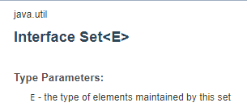
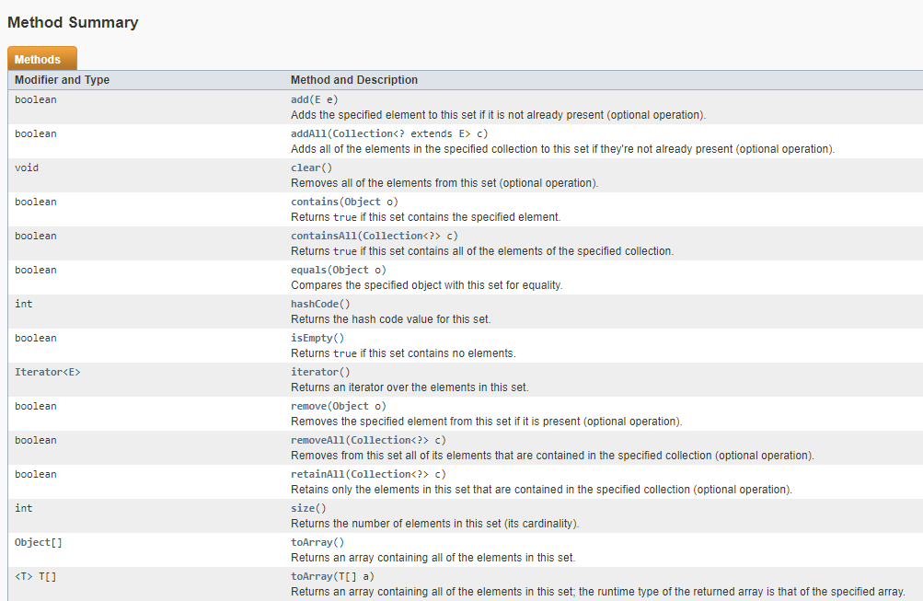
Java Class Library

